Slide 1
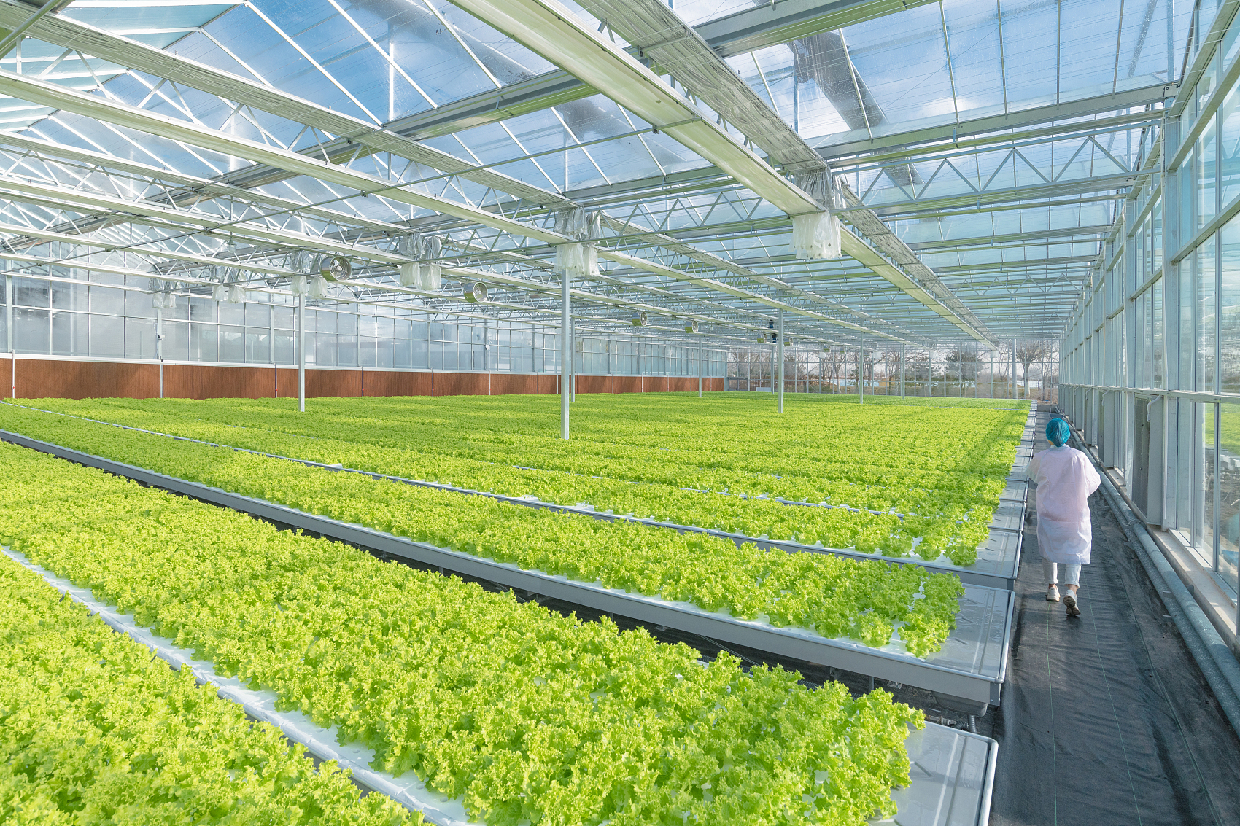

Hydroponics
Catalog
Smart Farming | Elegant Living
2025 ·December

Slide 2
catalog
Smart Farming, Elegant Living
01
02
03
Company Profile
Hydroponic Planting Rack
seedbed

Slide 3
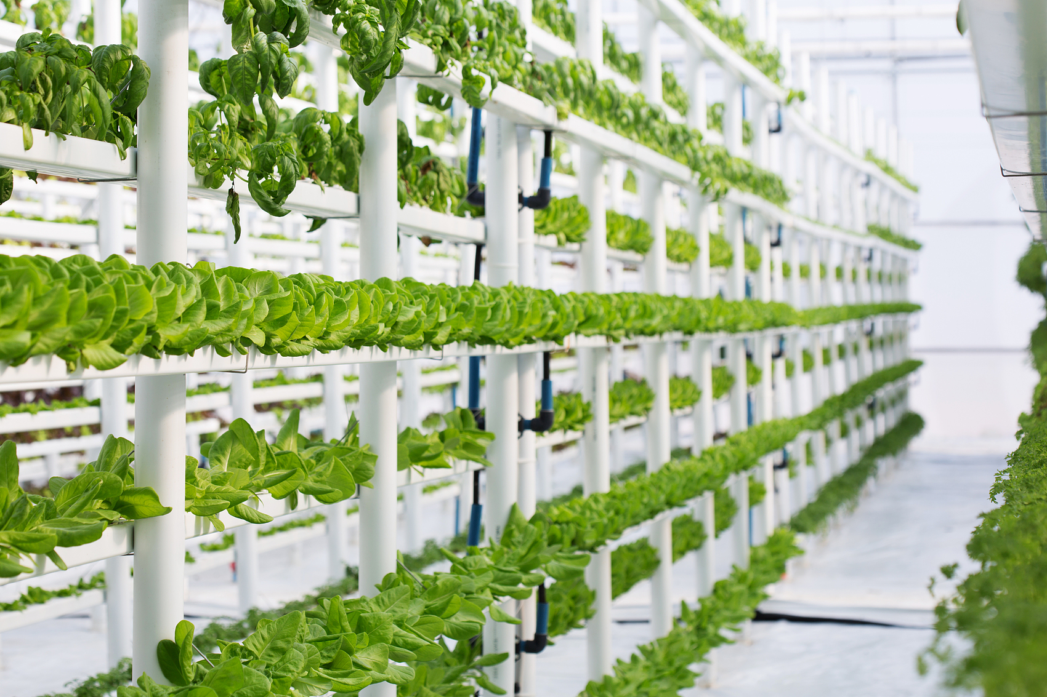
Company Profile
1
Smart Farming, Elegant Living
AURLANT
Each project is not just a farm - it's a living system of efficiency, balance, and growth.

Slide 4
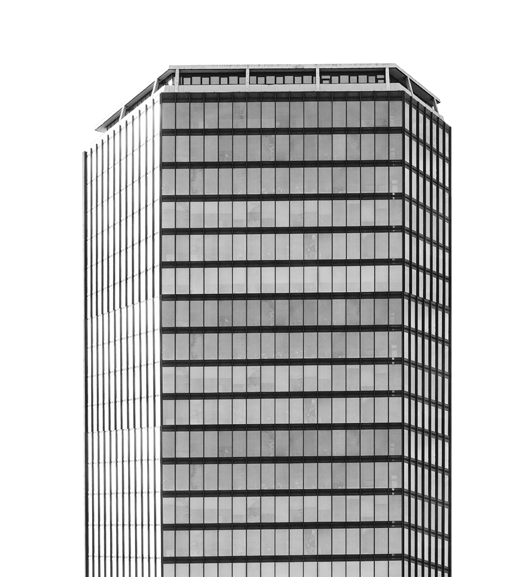
Company Profile
Brand Story
Aurlant In the evolving landscape of future agriculture, Aurlant was born from a belief:"Technology can make nature more efficient."Aurlant merges "Aurora" and "Plant," symbolizing the harmony between innovation and nature a light that guides the future of sustainable farming.We design and engineer advanced hydroponic systems, intelligent greenhouses, and Al-basedenvironment control to help growers around the world produce more with less - more yield, less energy, less waste.Every Aurlant solution reflects precision engineering, aesthetic design, and a deep respect fornature.
Each project is not just a farm - it's a living system of efficiency, balance, and growth.
good after-sales service
manufacture in-house
Expertise
Professional after-sales staff to answer your questions
Specialised 30,000 sq ft manufacturing material factory
Provision of complete technology for greenhouse cultivation
premium service
Professional factory
greenhouse technology

Slide 5
Milestones
2020
technically
perfect
2023
Client
Co-operation
One by one, international trade in intelligent, industrial, greenhouse growing technology and other landing applications
2021
Development
core
After years of research and development, the company has cooperated with a number of customers
2025
Continuing to
innovate
2019
Incorporation
After years of research and technical improvements, the company has been recognised by a number of companies
After years of international market research and study, the founding team finally established the company.
Strategic reorganisation, looking to the future, all perfected
Continuously transcend the pursuit of perfection

Slide 6
Hydroponic Planting Rack
2
Smart Farming, Elegant Living
AURLANT
Each project is not just a farm - it's a living system of efficiency, balance, and growth.

Slide 7
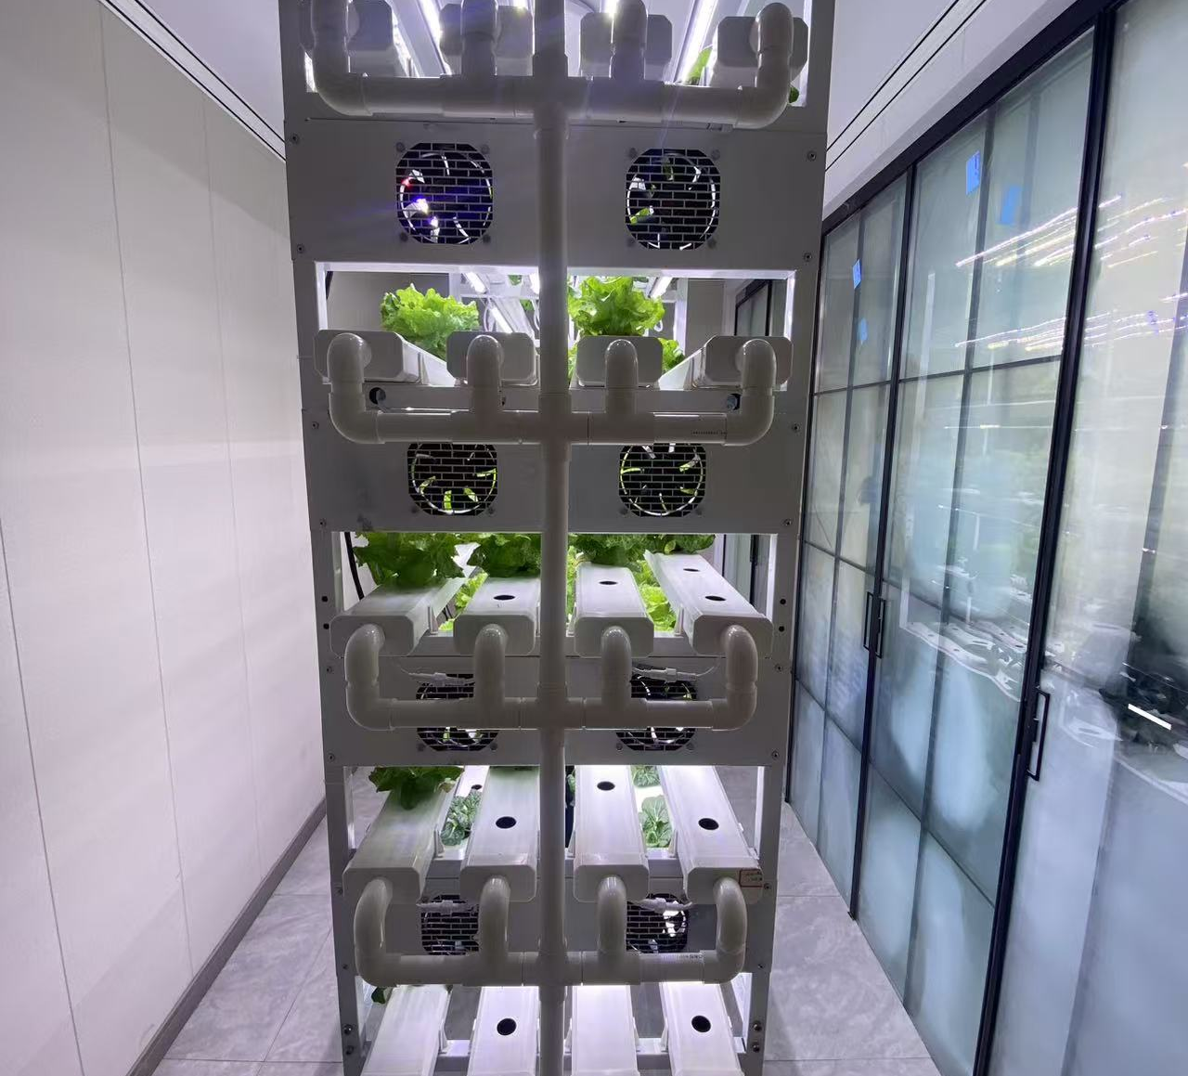
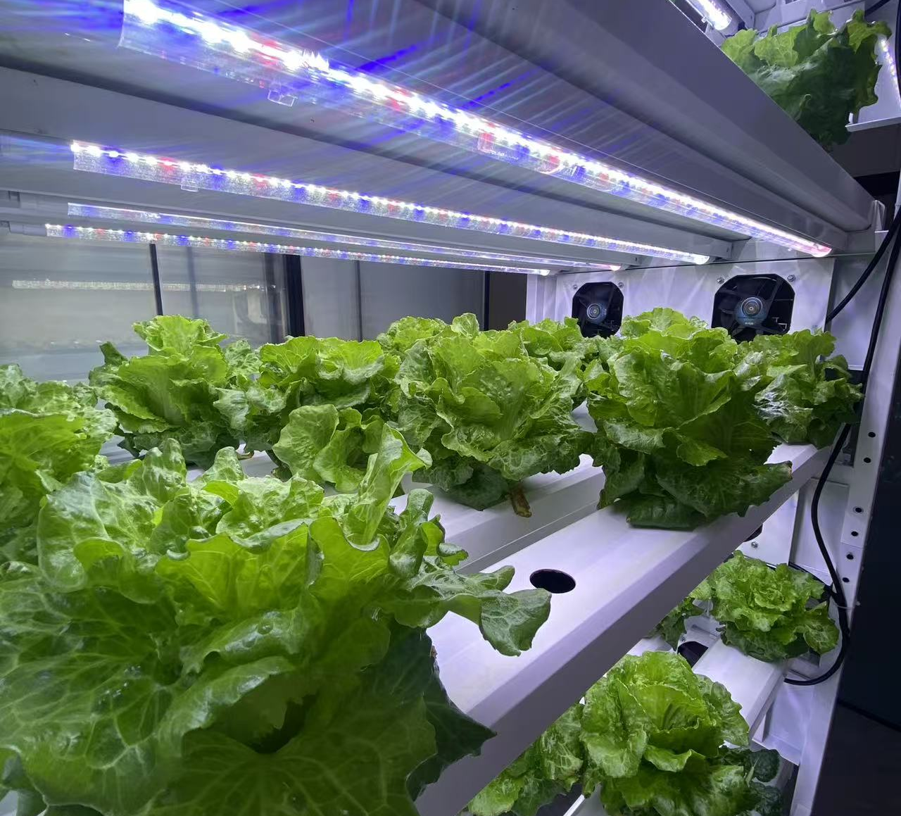
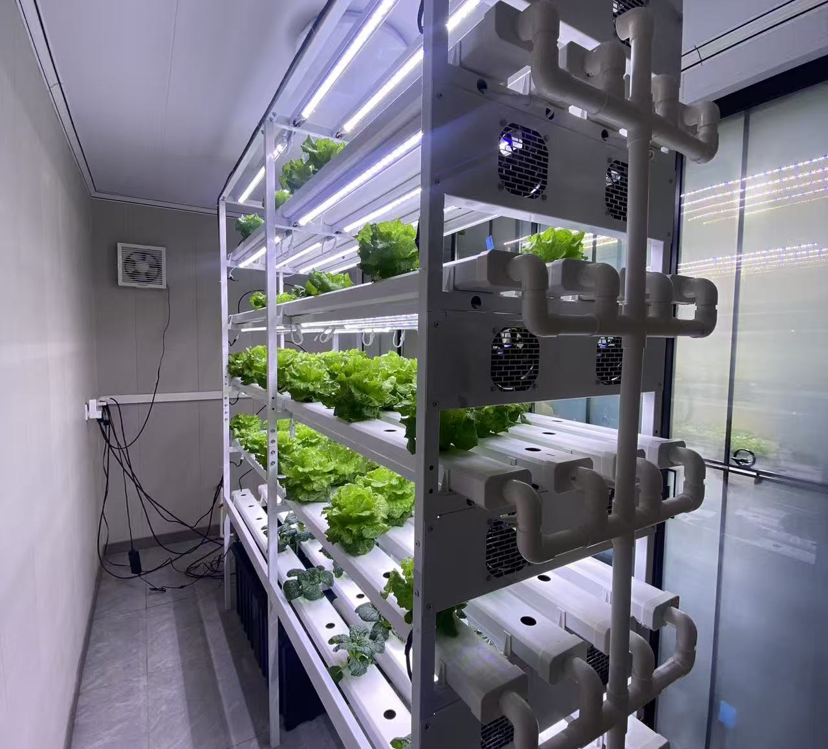
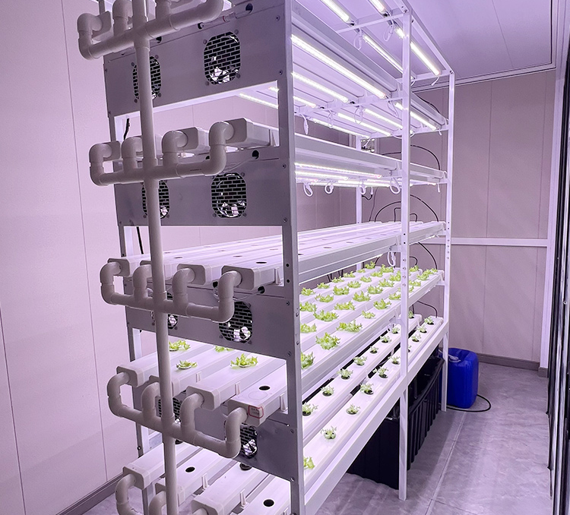
NFT Hydroponic Growing Rack
🇨🇦 Client from Canada – Urban Vertical Farming Project
Product Name: NFT Hydroponic Growing Rack
Hydroponic System: NFT (Nutrient Film Technique)
Suitable Crops: Lettuce, spinach, kale, herbs, leafy vegetables
Application Scenarios: Plant factory, vertical farm, greenhouse, container farm
Overall Size ：(L × W × H):2000 × 600 × 2000 mm (Customizable)
Number of Layers:3–6 layers available
NFT Channels per Layer:2–3 channels
Total Planting Holes:72 / 96 / 120 holes (depending on configuration)
Water Pump Power:25W / 40W (110V / 220V optional)
Water Tank Capacity:80–120 L (black anti-algae tank)
Main Accessories：NFT hydroponic channels 、 Support frame 、 Water pump
Water tank 、 Pipes and connectors 、 Net pots & sponges 、 LED grow lights (optional)
Basic Version (without lights)：USD 280 – 420 / set
With LED Lights:USD 420 – 650 / set

Slide 8
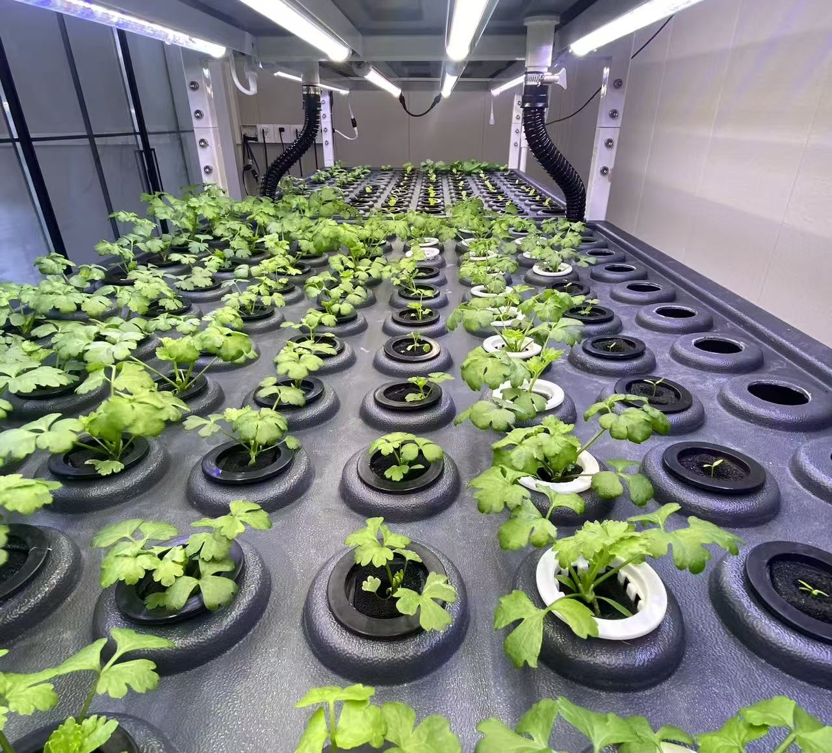
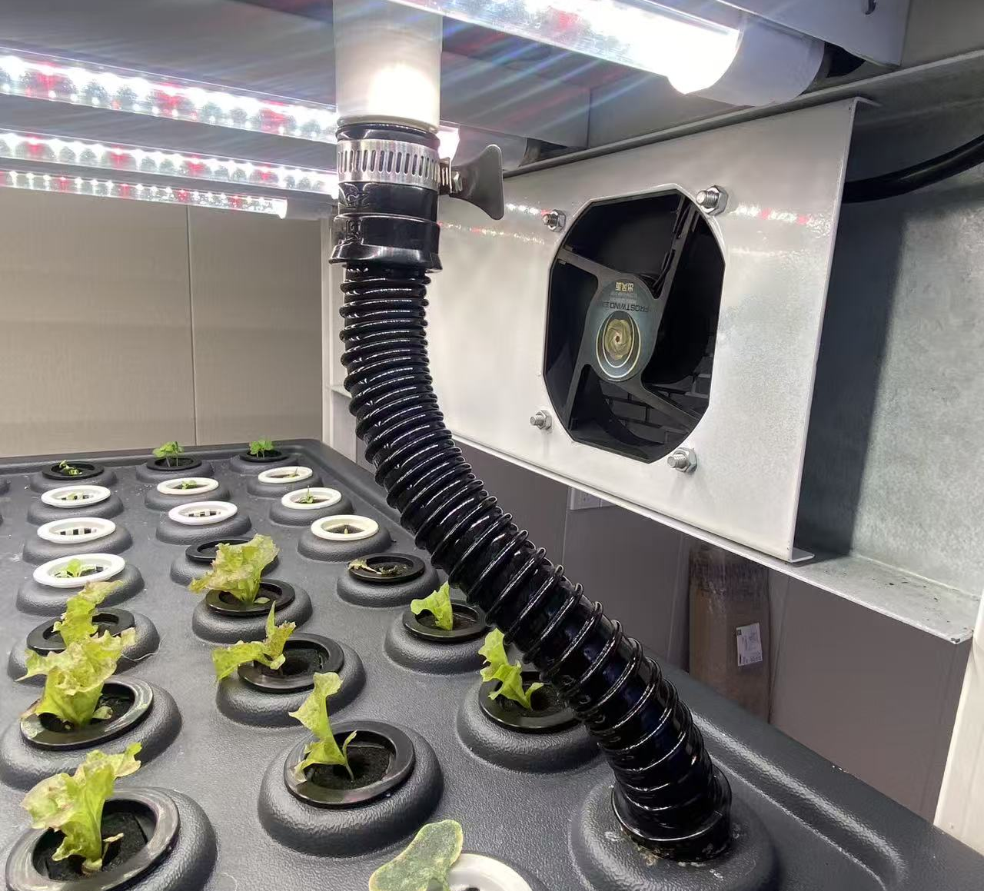
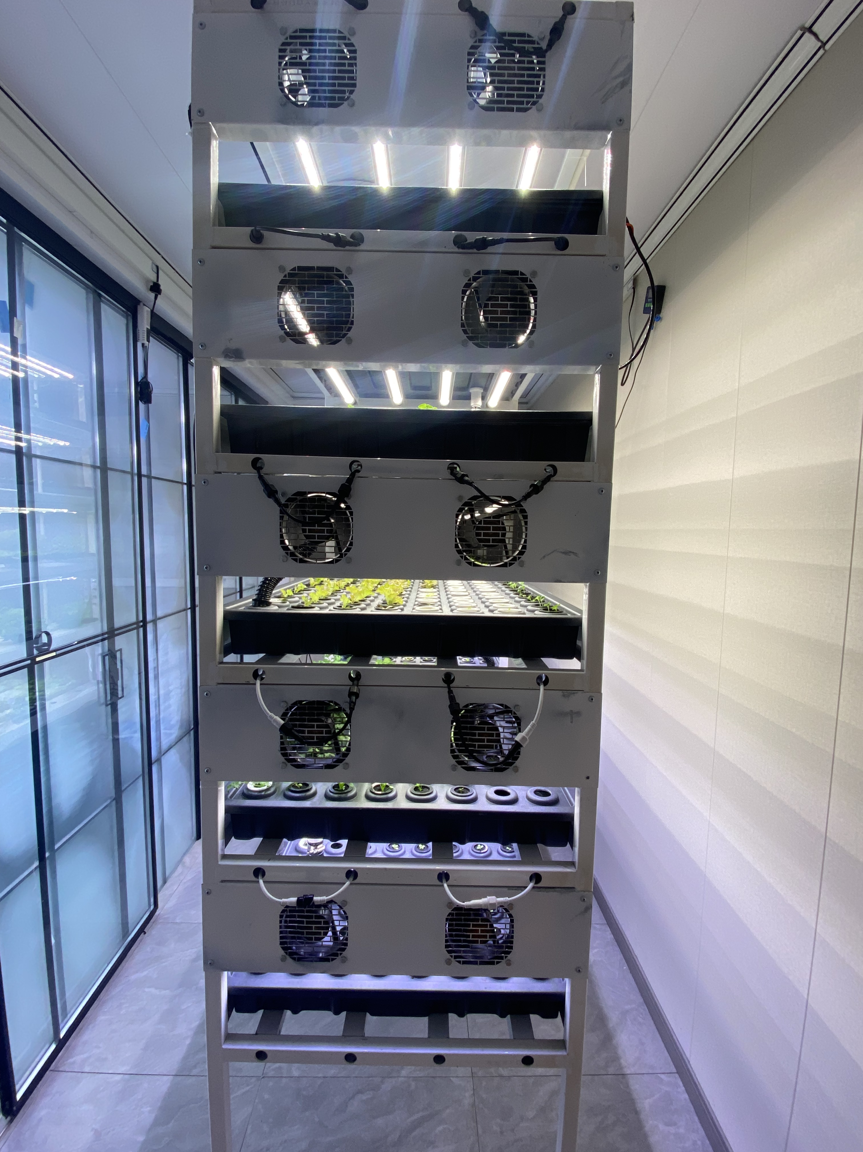
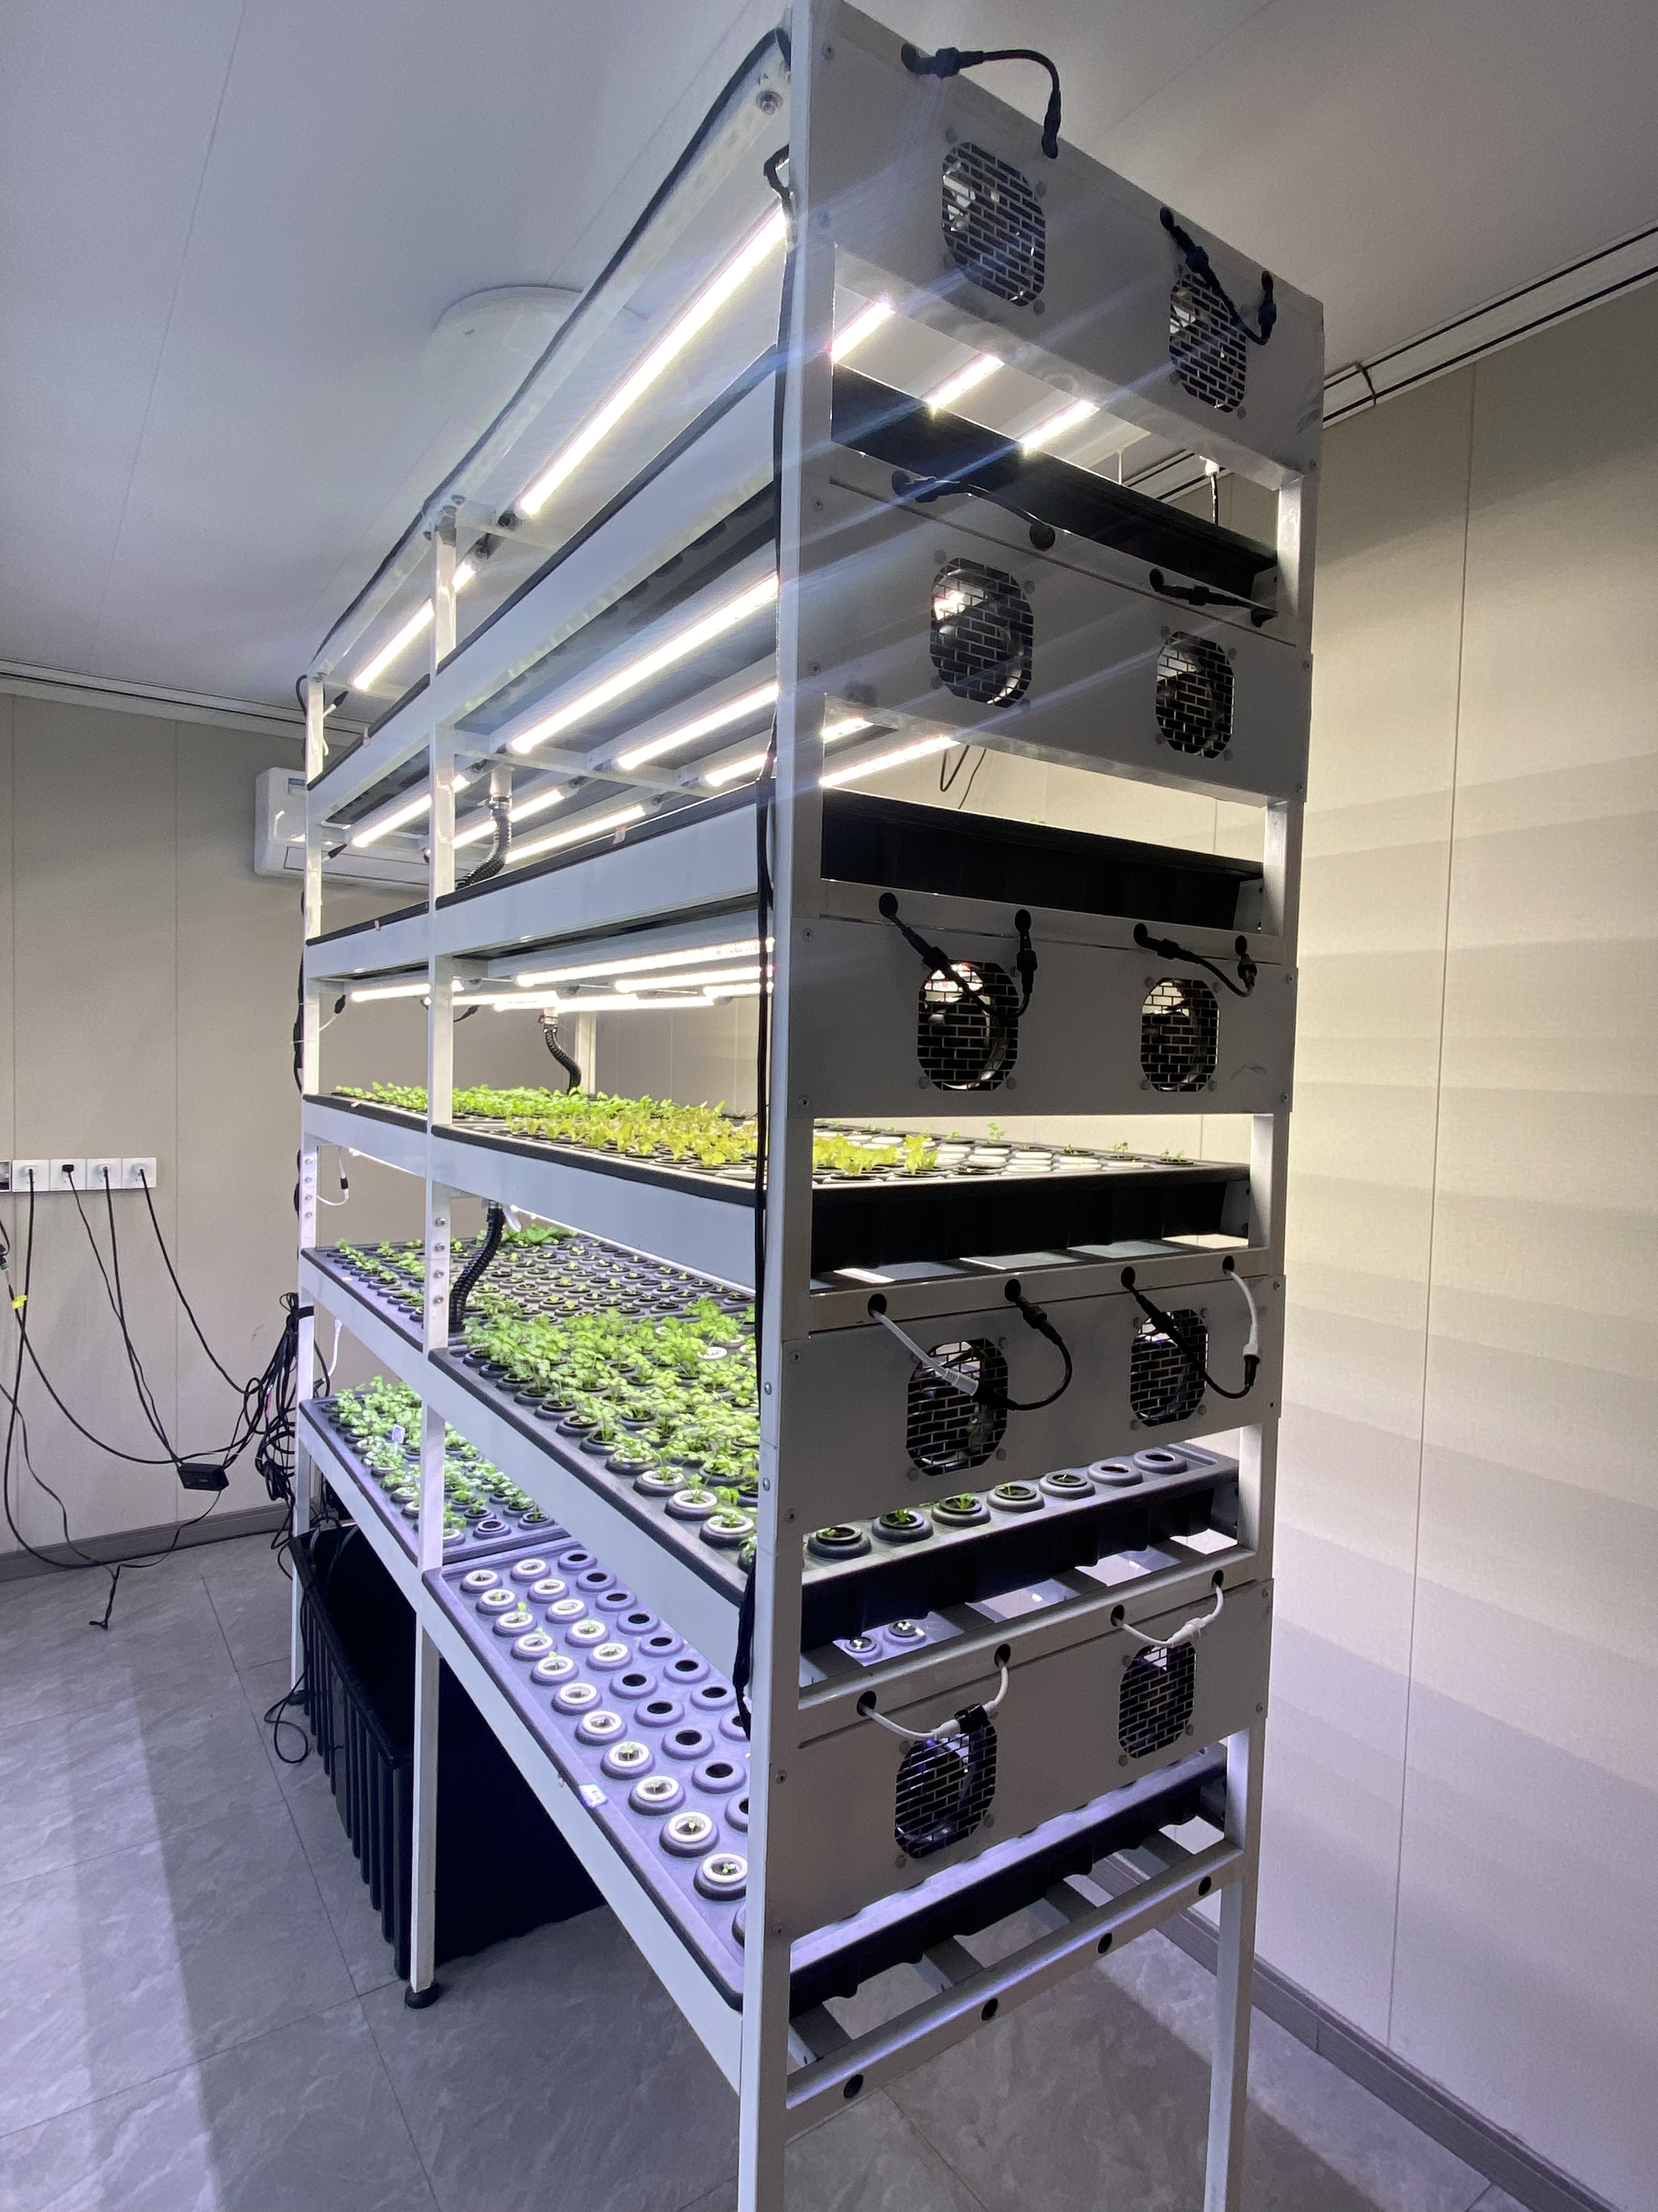
Indoor Vertical Seedling Rack
🇨🇦 Client from Canada – Urban Vertical Farming Project
Product Name: Indoor Vertical Seedling Rack
Standard Size (L × W × H):
Optional Height:
Number of Layers:4 / 5 / 6 layers (customizable)
Tray Types Supported:128-cell / 200-cell / 288-cell seedling trays
Total Plant Capacity per Rack:Approx. 800–2000+ seedlings
Total Plant Capacity per Rack:Approx. 800–2000+ seedlings (depending on configuration)
Shelf Panels:Waterproof PVC board / ABS molded tray
Light Type: Full-spectrum LED grow lights
Power Consumption:30–50W per layer
Photoperiod Control:Timer or controller supported
Water Tank Capacity (Optional):50–100 L
Basic Model (No lights / No system):USD 180–300 / set
Model with LED & Fans:USD 350–600 / set

Slide 9
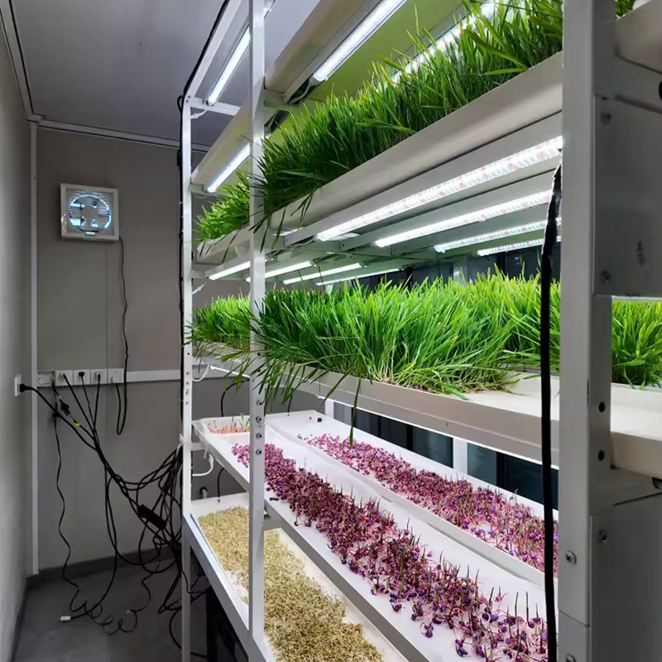
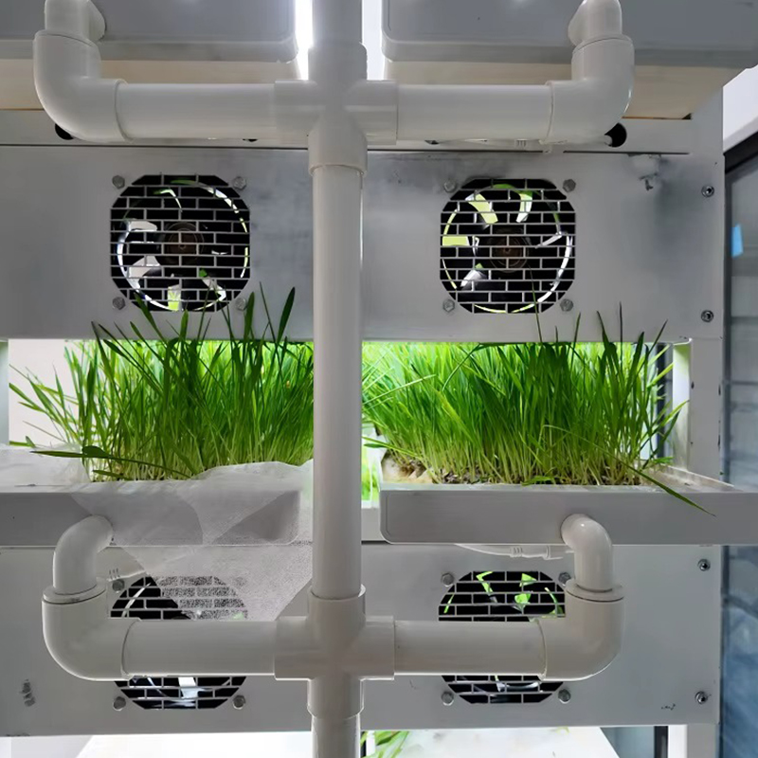
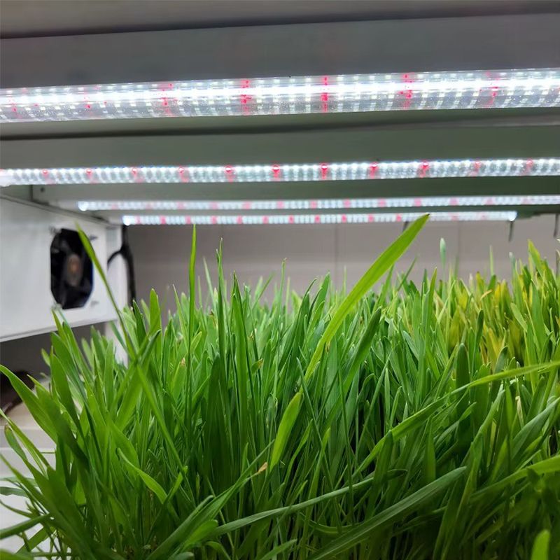
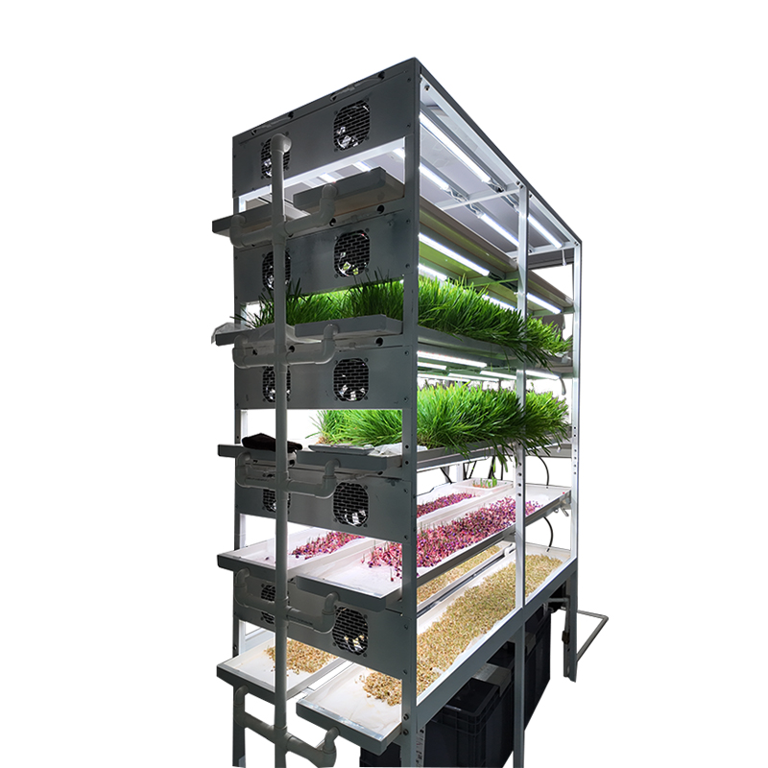
Hydroponic Feed Growing Rack
🇨🇦 Client from Canada – Urban Vertical Farming Project
Product Name: Hydroponic Feed Growing Rack
Standard Size (L × W × H):
Number of Layers:5 / 6 / 7 layers (customizable)
Daily Output per Rack (Reference):40–80 kg (7–10 day growth cycle, depending on seed type)
Main Frame:Galvanized steel / Aluminum alloy / Powder-coated steel (optional)
Planting Trays:Food-grade ABS or PP injection-molded trays
Light Type:Full-spectrum LED grow lights
Water Tank Capacity:80–120 L (customizable)
Water Pump Power:40–60W
Circulation Mode:Automatic water recycling, water-saving rate ≥80%
Basic Model (without smart control):USD 300–500 per set
Full Configuration (LED + fans + hydroponic system):USD 600–900 per set

Slide 10
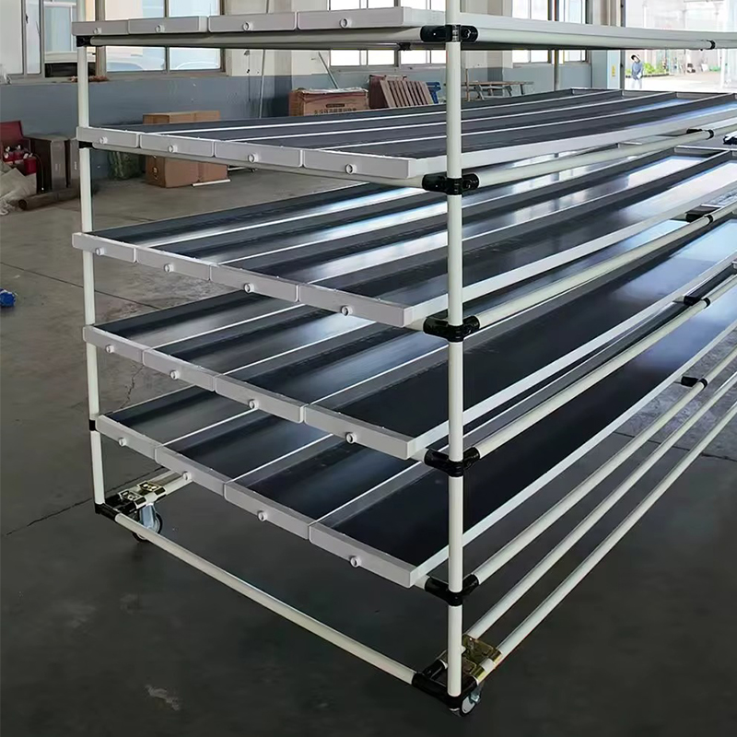
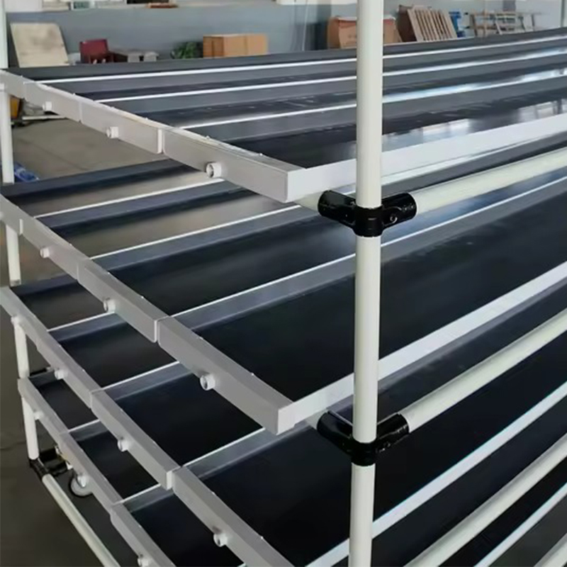
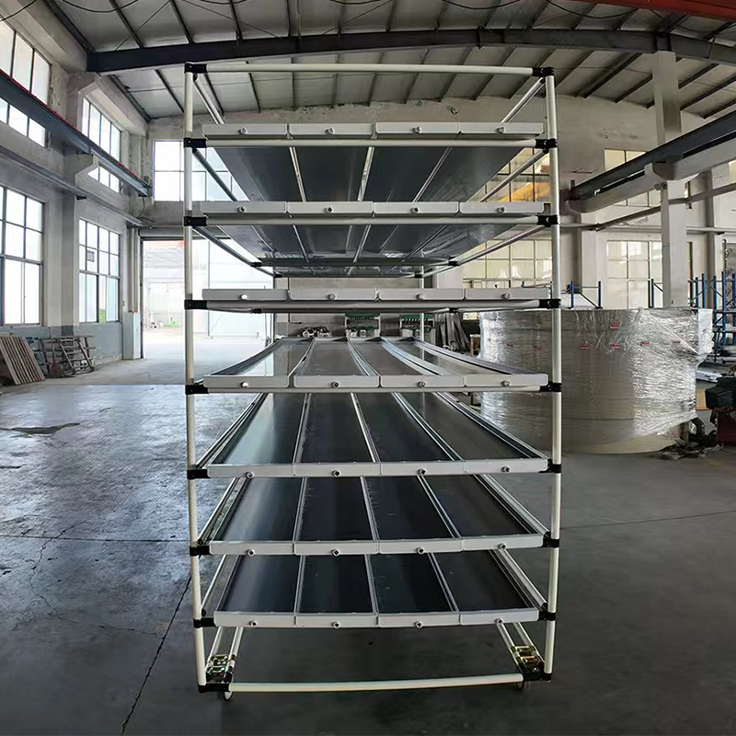
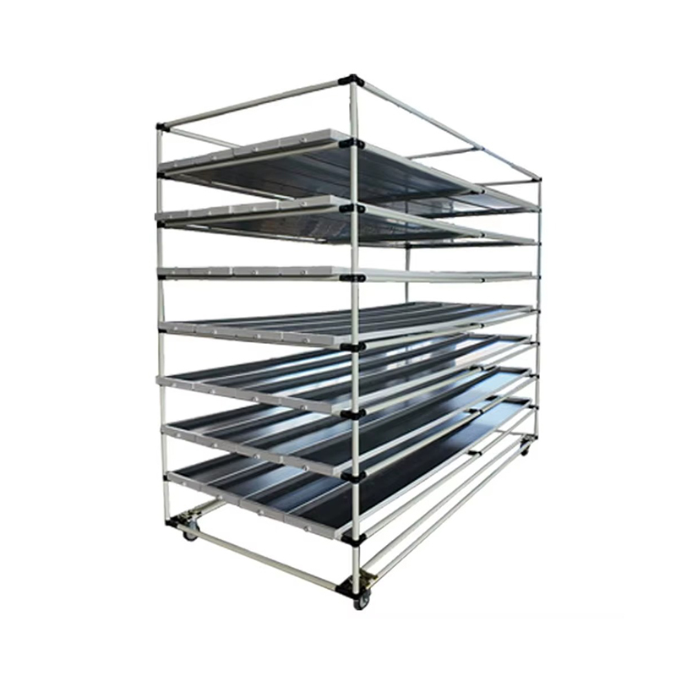
New PVC Hydroponic Fodder Growing Rack
🇨🇦 Client from Canada – Urban Vertical Farming Project
Product Name: Old PVC Hydroponic Fodder Growing Rack
Standard Size (L × W × H):
Number of Layers:5 / 6 / 7 layers (customizable)
Daily Output (Reference):30–70 kg per rack
(7–10 days growing cycle, depending on fodder type)
Main Frame:High-strength PVC pipes with industrial-grade connectors
Features:Waterproof, corrosion-resistant, rust-free, ideal for high-humidity environments
Algae Prevention
Suitable Crops:Barley grass, wheatgrass, oat grass, alfalfa and other fodder crops
Water Tank Capacity:60–100 L (customizable)
Water Pump Power:30–50 W
Water Saving Rate:≥80% with recirculating design
Basic Version (without pump):USD 180–300 / set
Complete System (pump + trays):USD 300–500 / set

Slide 11
seedbed
3
Smart Farming, Elegant Living
AURLANT
Each project is not just a farm - it's a living system of efficiency, balance, and growth.

Slide 12
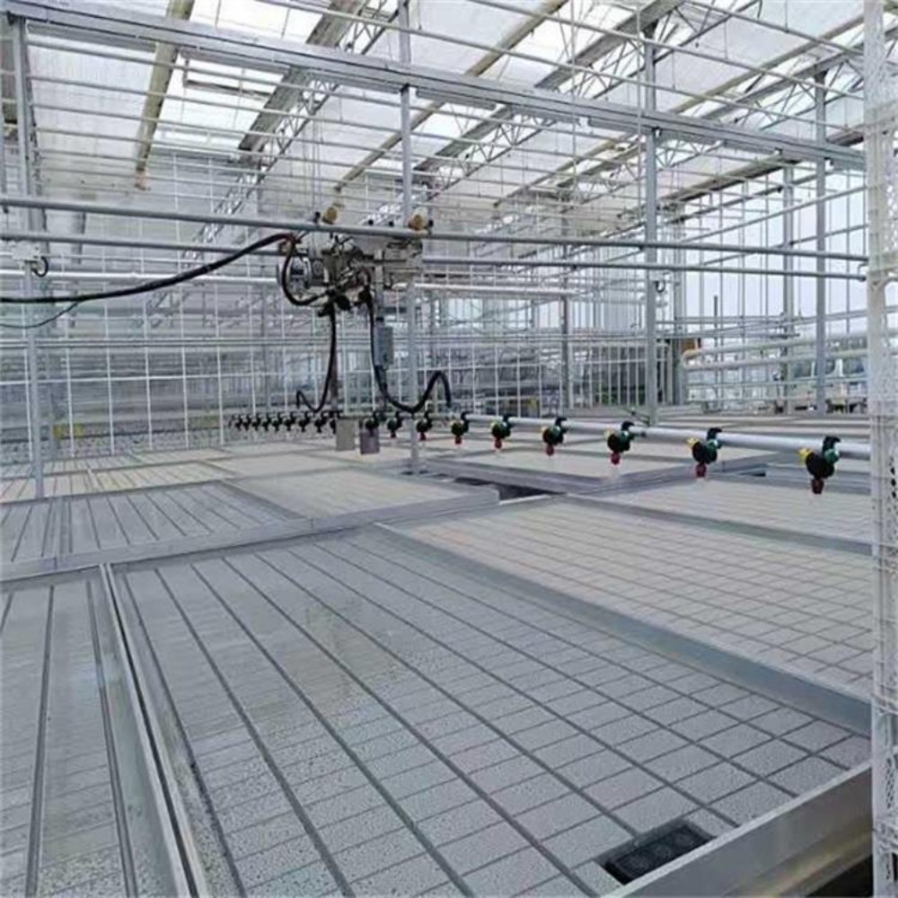
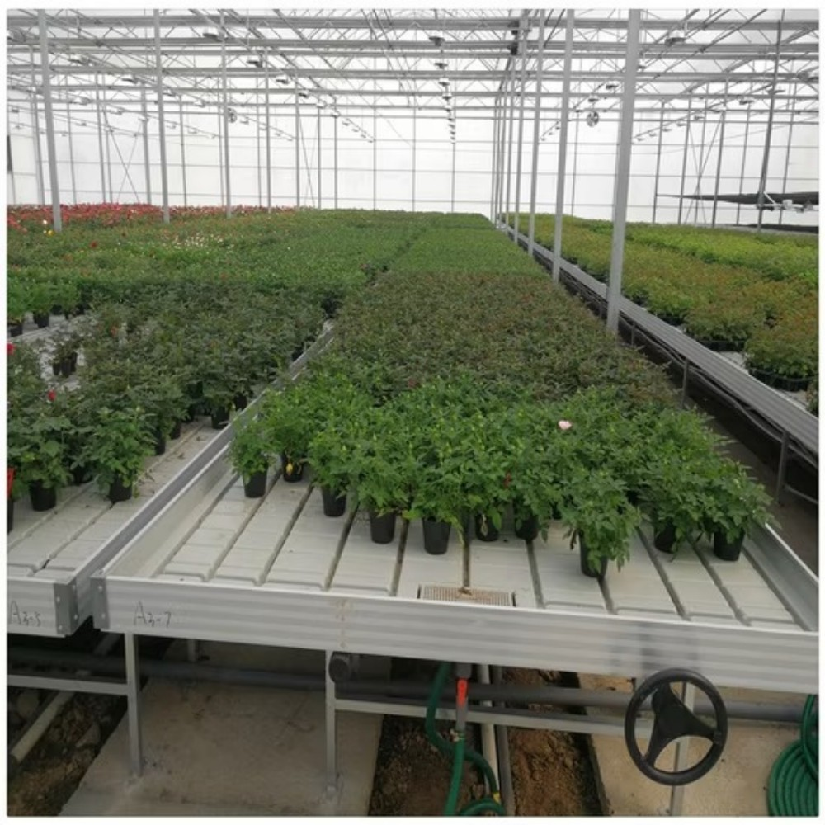
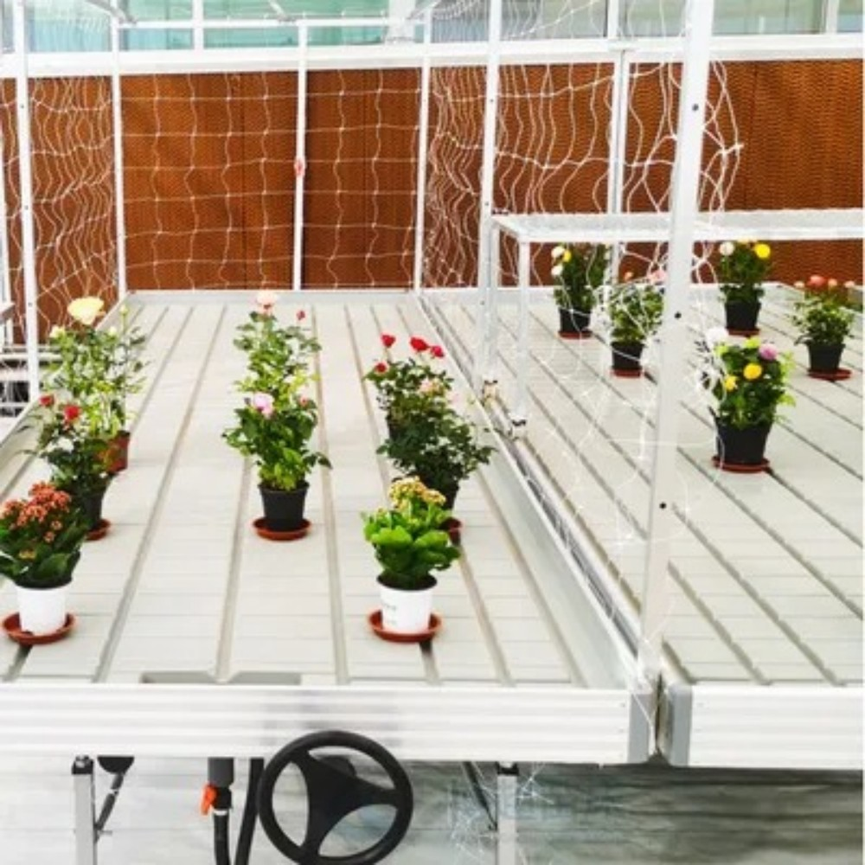
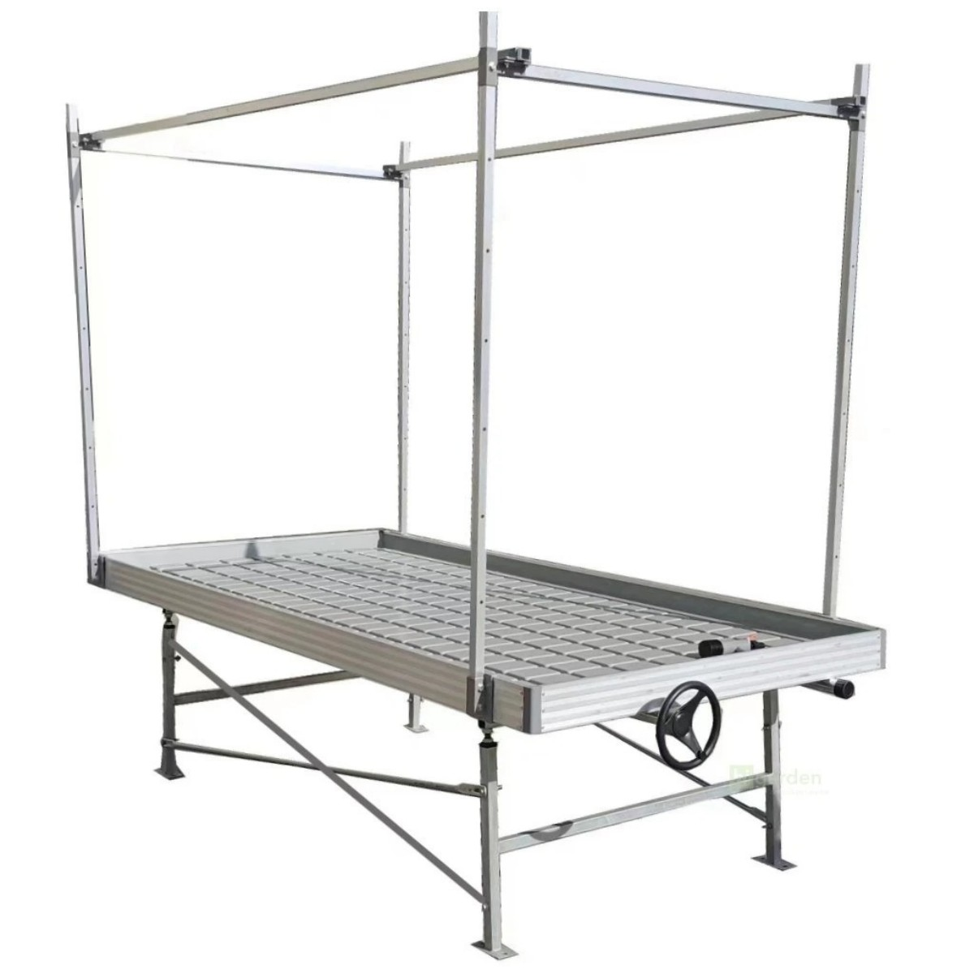
Tidal Nursery Bed
🇨🇦 Client from Canada – Urban Vertical Farming Project
Product Name: Tidal Nursery Bed
Standard Size (L × W × H):
Bench Surface Material:Aluminum ebb & flow tray / Galvanized steel tray
Frame Material:Hot-dip galvanized steel
Load Capacity:≥ 80–100 kg/m²
Irrigation Method:Ebb & flow irrigation (timed flooding and automatic drainage)
Suitable Crops：Vegetable seedlings (lettuce, tomato, pepper, etc.) 、 Flower seedlings
Fodder grass & hydroponic seedlings 、 Cutting propagation and nursery plants
Control Type:Manual control / Timer control / Intelligent control (optional)
Compatible Systems (Optional):Greenhouse controller, water pump, EC & pH monitoring system
Application Scenarios：Glass greenhouse / Plastic film greenhouse
Commercial seedling nurseries 、 Hydroponic farms 、 Modern facility agriculture projects
Single-layer Ebb and Flow Bench:USD 120–300 / set

Slide 13
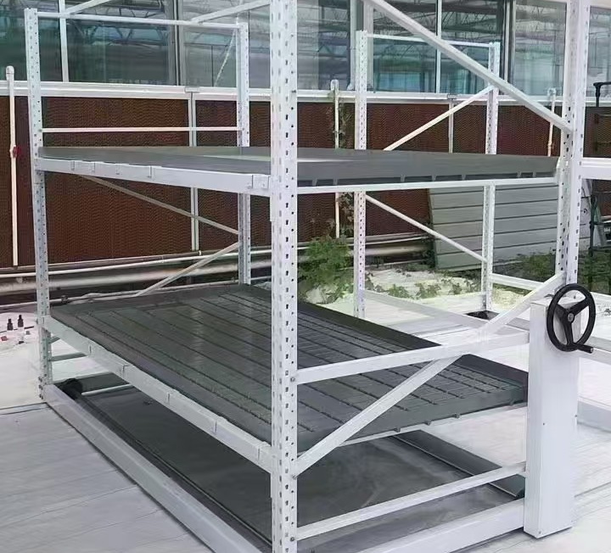
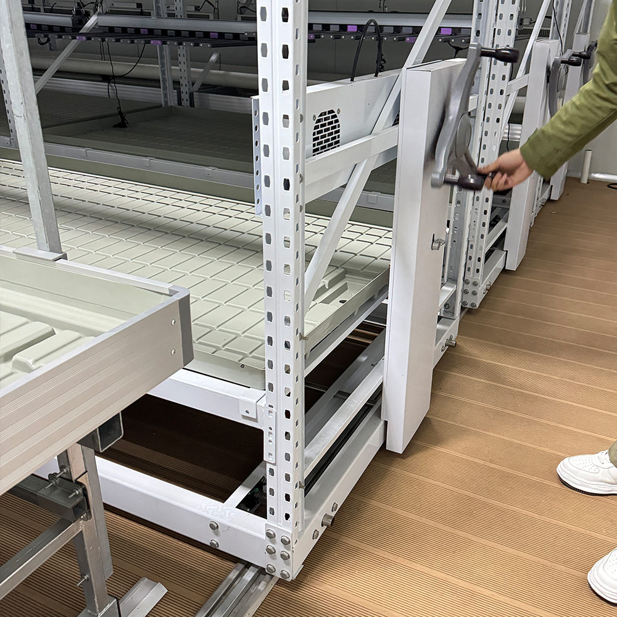
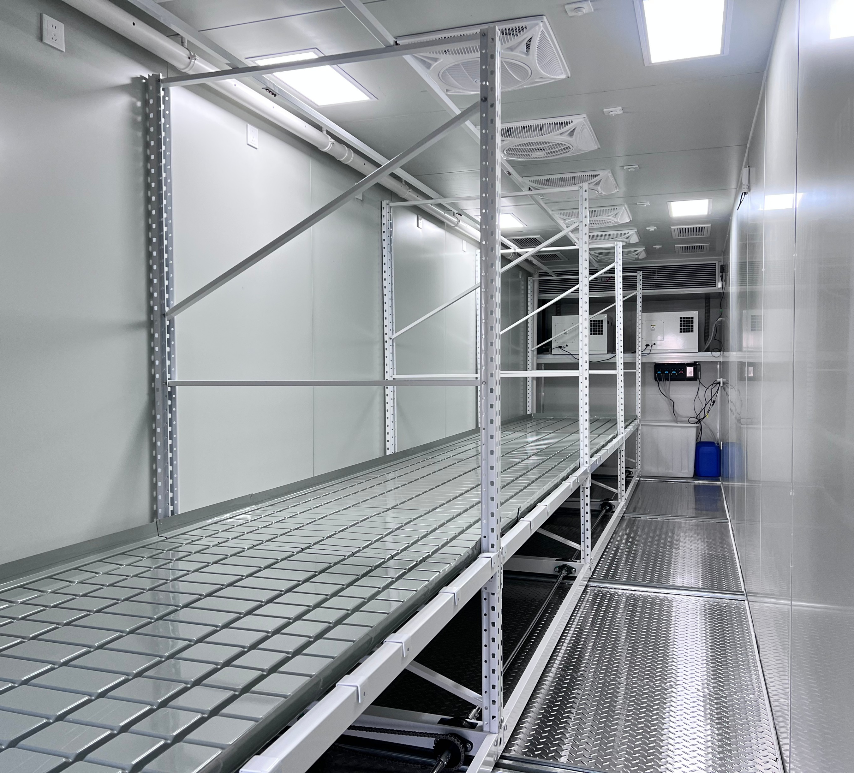
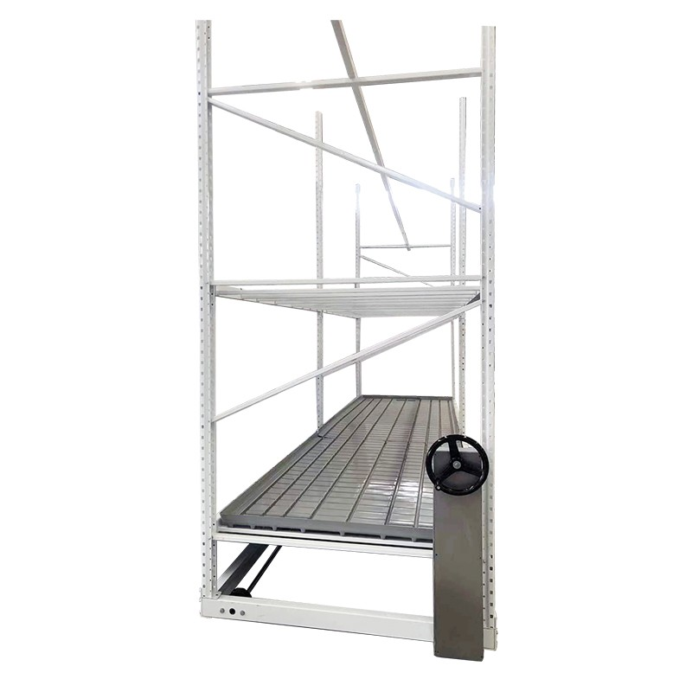
Rail-mounted seedling bed
🇨🇦 Client from Canada – Urban Vertical Farming Project
Product Name: Rail-mounted seedling bed
Standard Size (L × W × H):
Working Height:650–800 mm (adjustable)
Moving Range:Side-to-side rolling to maximize greenhouse space utilization
Bench Surface:Aluminum alloy bench panels / Hot-dip galvanized steel panels
Frame:Hot-dip galvanized steel tubes (corrosion-resistant)
Load Capacity:≥ 80–120 kg/m²
Optional Systems：Ebb & Flow irrigation system 、 Overhead sprinkler / drip irrigation
LED grow lights 、 Greenhouse climate control system
Suitable Crops：Vegetable seedlings (lettuce, tomato, pepper, etc.)
Flower seedlings 、 Strawberry seedlings 、 Forage grass and hydroponic seedling trays
Application Scenarios：Glass greenhouses 、 Plastic film greenhouses
Commercial nurseries 、 Modern agricultural parks 、 Hydroponic farms and plant factories
Manual Rolling Bench:USD 120–300 per set
Electric Rolling Bench:USD 300–600 per set

Slide 14
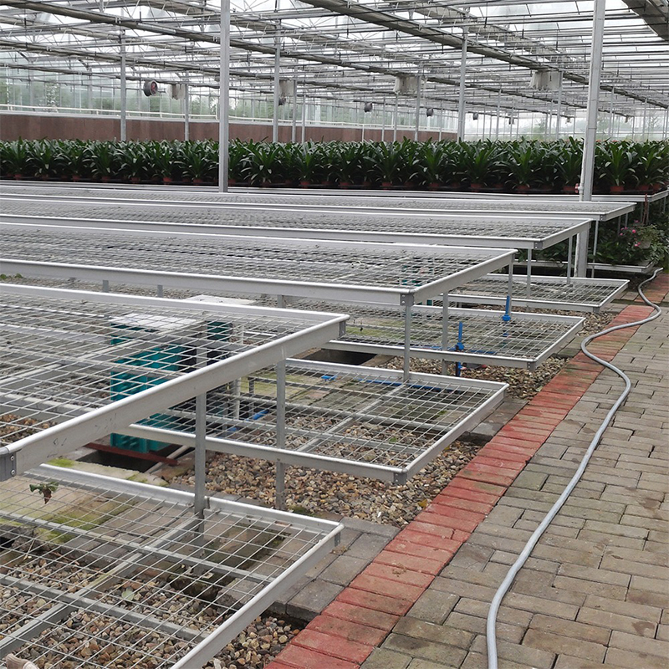
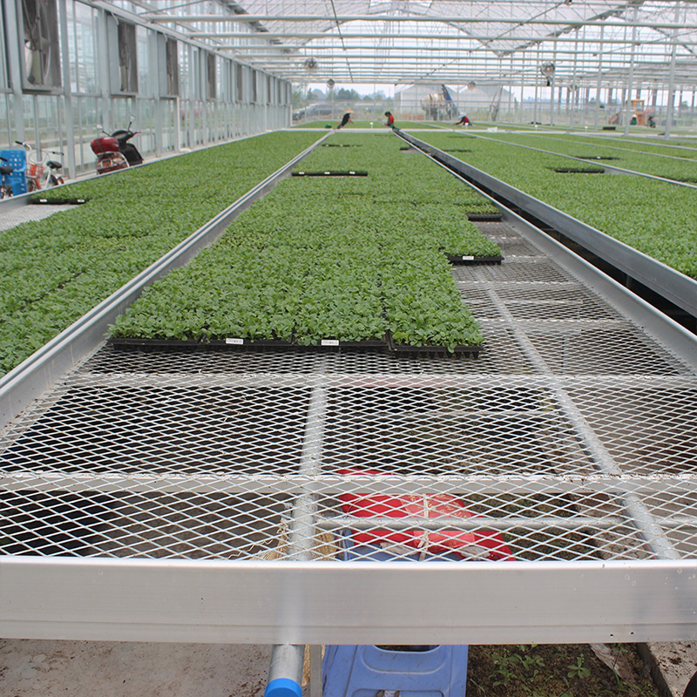
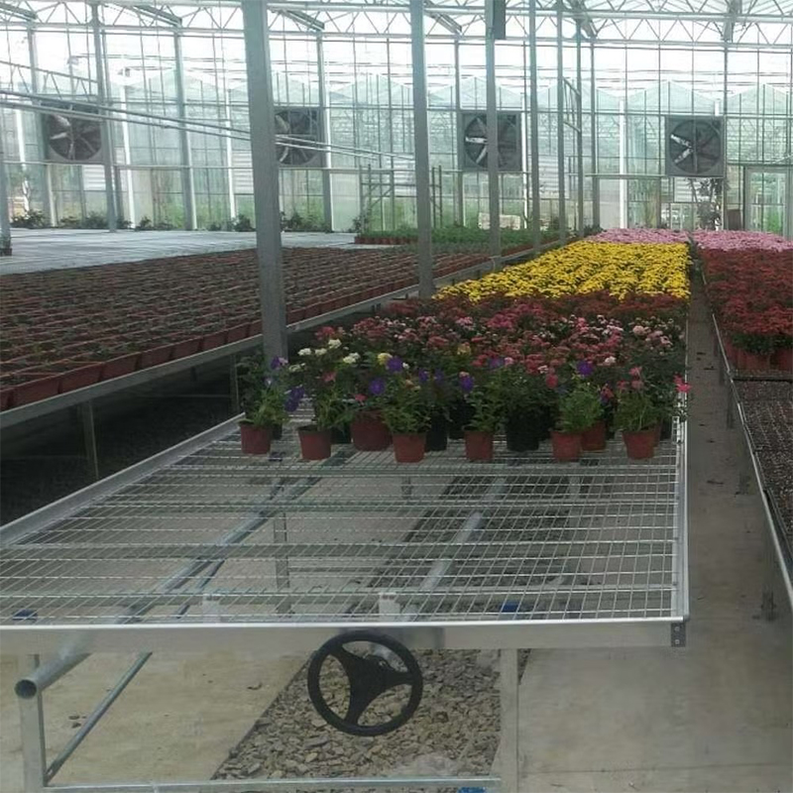
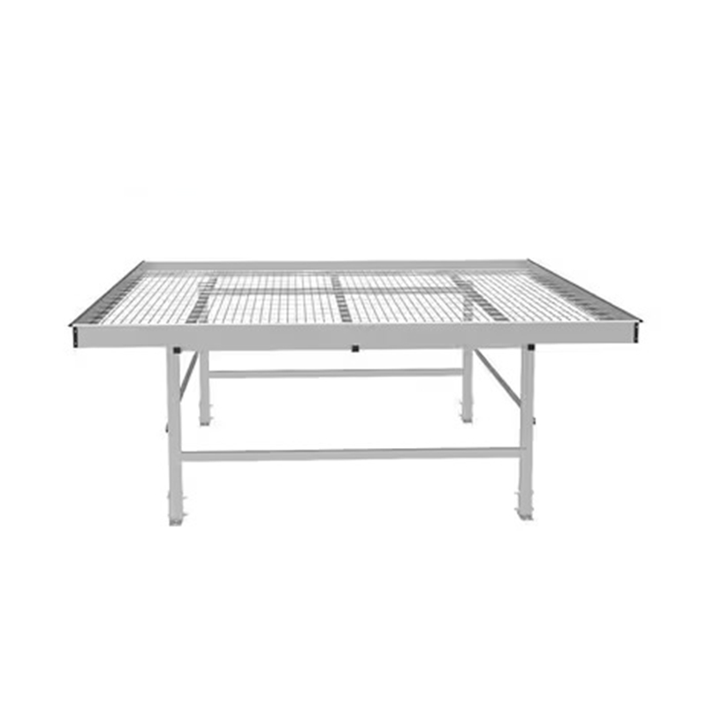
Wire mesh seedbed
🇨🇦 Client from Canada – Urban Vertical Farming Project
Product Name: Wire mesh seedbed
Standard Size (L × W × H):
Surface Type: Steel wire mesh
Frame: Reinforced galvanized steel edge frame to prevent deformation
Bench Frame: Hot-dip galvanized steel tubes
Wire Mesh Material: Hot-dip galvanized wire / Electro-galvanized wire
Corrosion Resistance: High, suitable for high-humidity greenhouse environments
Service Life: 8–15 years
Suitable Crops：Vegetable seedlings (lettuce, tomato, pepper, etc.)
Flower seedlings 、 Strawberry plants 、 Fodder grass and hydroponic seedling trays
Suitable Crops：Vegetable seedlings (lettuce, tomato, pepper, etc.)
Flower seedlings 、 Strawberry plants 、 Fodder grass and hydroponic seedling trays
Price：USD 50 – 150 per set

